Slide 1
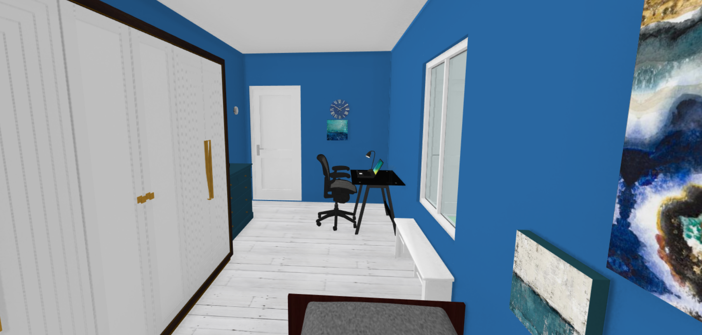
Smart Home
Alex, Oscar, Choi, Sam, Long

Slide 2
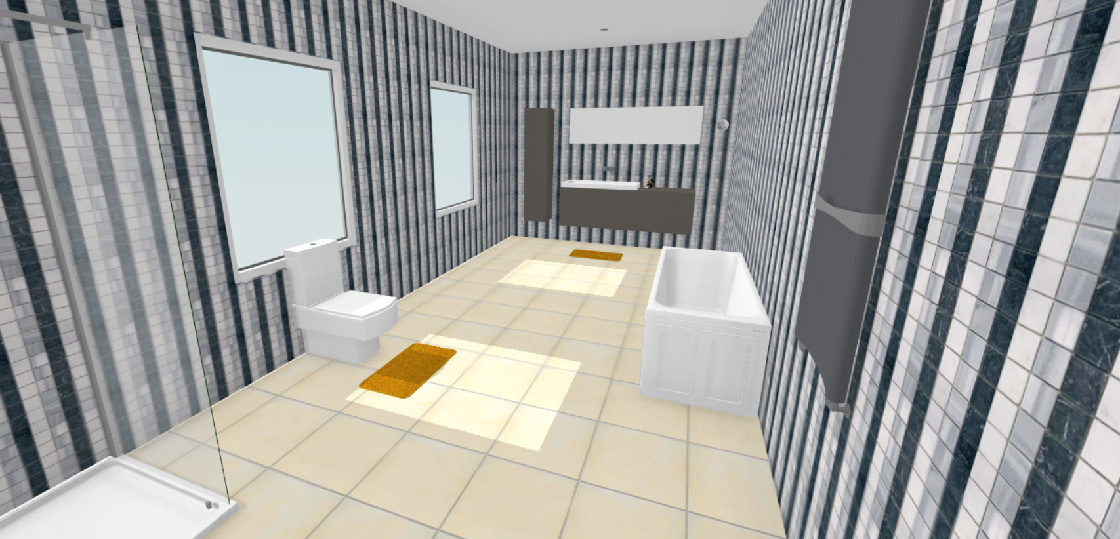
Outline
Overview
Current challenges
Innovation and improvement
Class diagram
Layout of the house

Slide 3
Overview and systems included in the setup
Device Manager: control communication of
Smart TV: have port for ethernet but also can connect to Wi-Fi.
Air conditioner: with micro-dust filter / air purifier
Thermostats: works with air conditioner/air purifier, warns user about problematic weather (temperature too high/low, too much pollution in the air etc), and turns air conditioner/air purifier on when necessary.
Smoke/Fire Alarm: automatically shutdown all electrical systems and calls firefighters in case of fire.
Network-attached storage (NAS)/Home server: Local storage using intranet.
Smart lightning: controlled via voice and via app. Can set up timer.
Smart lighting in hallway uses motion detector.
Electronic appliances: can control with the app. Timer function.

Slide 4
Overview and systems included in the setup
Smart toilet
Smart water heater: in case of electric water heater: can turn on with the app, then automatically turn off before use for safety reasons.
Washing machine: can view process with the app.
Security camera: Automatically warns user if there’s any person detected (using motion sensor + camera). Camera footage is saved directly in the local NAS and automatically delete after 30 days.
Smart lock: lock can be controlled only by authorized devices.
Smart doorbell (with camera): can view through the app.

Slide 5
Current Challenges
Complicated hardware setup
Limitation of Wi-Fi network range
Privacy & Security: concern over data breach
False motion sensor detection
Once the wifi password is changed, all the devices needed password change

Slide 6
Innovation and improvement
Vacuum bot: Can load a layout file of the room to setup the most efficient cleaning route.
Augmented reality: Can see all the information with class. In-person assistant.
Security camera: Can detect different shapes to recognise humans or animals for more accurate warning. Can setup in different modes for ease of use (i.e. no one enters at certain times or only people with phones connected to the app can enter the house without warning being tripped.)
Smart temperature regulation: Regulate temperatures based on thermostats. Include a floor heating.
Emergency mode: When natural disasters hits. Cuts all electricity and gas and unlock the doors. When there is an intruder, call authorities and locks all of the doors.

Slide 7
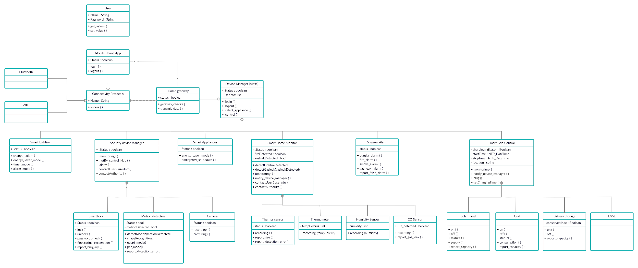
Class Diagram
https://app.creately.com/diagram/2Txu2kvcwhV/edit

Slide 8
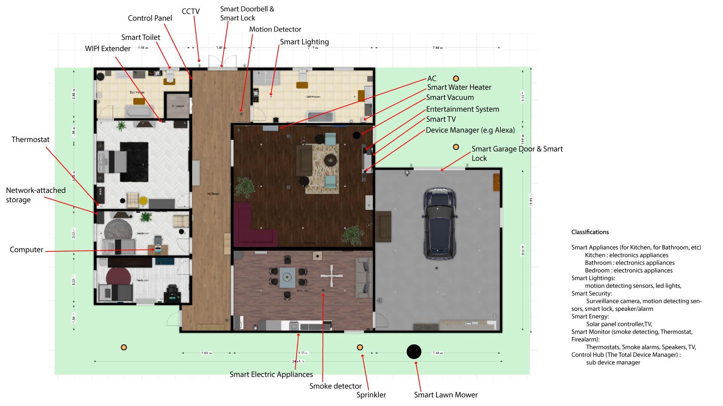
Layout of the house
House layout and design link: https://tinyurl.com/yydtcatq

Slide 9
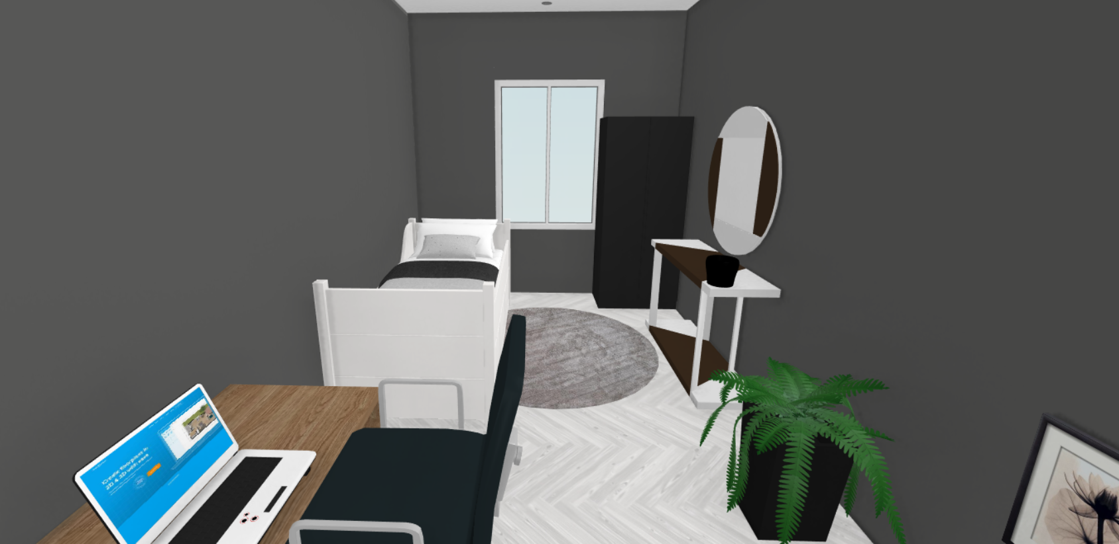
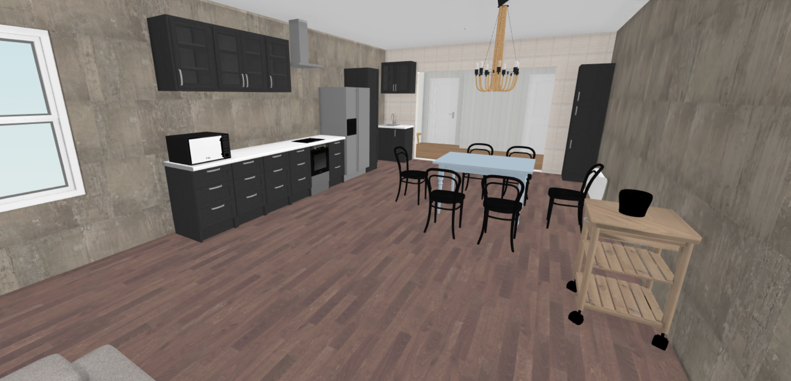
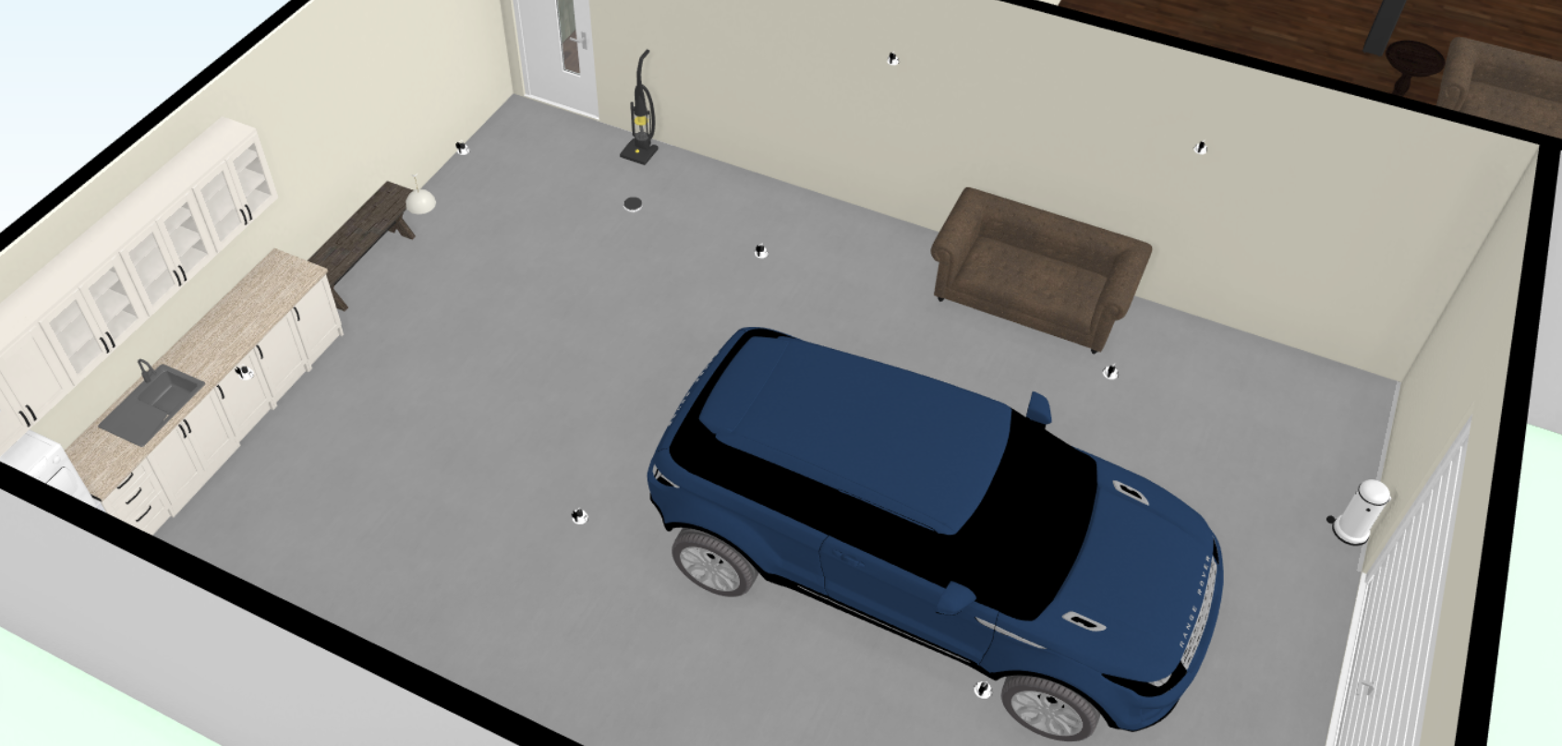
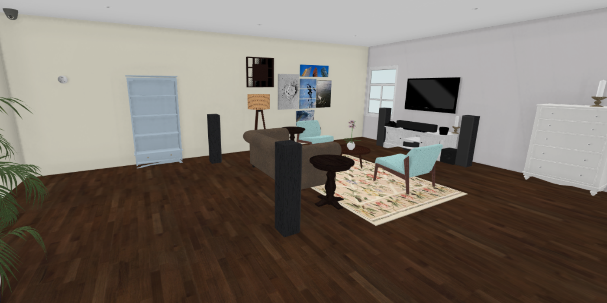
3D Images of the house

Slide 10
Thank you for listening

